Slide 1
Trees and Graphs
Trees and Graphs Fundamentals, Terminology and Traversal Algorithms
7
19
21
14
1
12
31
23
6
SoftUni Team
Technical Trainers
Software University
https://softuni.bg

Slide 2
Table of Contents
Trees and Related Terminology
Node, Edge, Root, etc.
Traversing Tree-Like Structures
BFS traversal
DFS traversal
Graph Definitions and Terminology
Representing Graphs
Graph Traversal Algorithms
Depth-First-Search (DFS)
Breadth-First-Search (BFS)
2

Slide 3
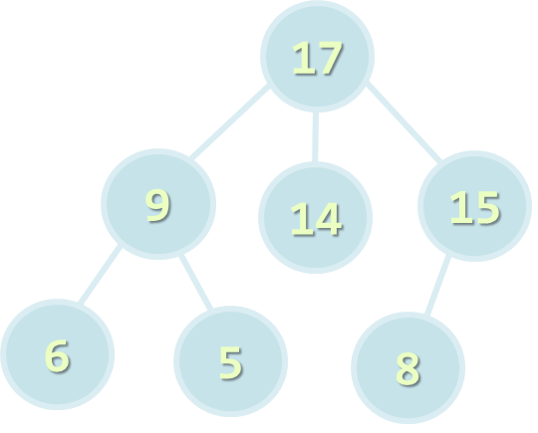
Trees

Slide 4
Tree Definition
Tree is a widely used abstract data type (ADT) that simulates a hierarchical tree structure:
Value
Parent – null or another tree reference
Children – collection of trees
Recursive definition – a tree consists of a value and set of child nodes, which are trees
By working with trees you can actually work with:
Hierarchical structures, markup languages, DFS and BFS algorithms
7
19
21
14
1
12
31
23
6
4

Slide 5
Tree Data Structure – Terminology
Node – a structure which may contain a value or condition or represent a separate data structure
Edge – the connection between one node and another
Root – the top node in a tree, the prime ancestor
Root
Edge
17
Node
9
14
15
6
5
8

Slide 6
Tree Data Structure – Terminology
Parent – an immediate ancestor
The converse notion of a child
Child – an immediate descendant
Node directly connected to another node when moving away from the root
Siblings – a group of nodes with the same parent
Parent
17
9
14
15
Child
6
5
8
Sibling
Sibling

Slide 7
Tree Data Structure – Terminology
Ancestor – node reachable by repeated proceeding from child to parent
Descendant – node reachable by repeated proceeding from parent to child
Leaf – node with no children
Branch – node with at least one child
Ancestor
Descendant
17
Branch
9
14
15
6
5
8
Leaf

Slide 8
Tree Data Structure – Terminology
Degree – number of children for node zero for a leaf
Path – sequence of nodes and edges connecting a node with a descendant
Distance – number of edges along the shortest path between two nodes
Depth – distance between a node and the root
Degree: 2
17
Path of distance: 2
9
14
15
6
5
8

Slide 9
Tree Data Structure – Terminology
Level – depth + 1
Height – the maximum level in the tree
The number of edges on the longest path between a node and a descendant leaf
Width – number of nodes in a level
Breadth – number of leaves
Height: 3
17
9
14
15
6
5
8
Breadth: 3

Slide 10
Tree Data Structure – Terminology
Forest – set of disjoint trees
{17}, {9, 6, 5}, {14}, {15, 8}
Sub tree – tree T is a tree consisting of a node in T and all its descendants in T
17
9
14
15
6
5
8
Sub tree

Slide 11
Tree<int> Structure – Example
7
children
19
children
21
children
14
children
1
children
31
children
23
children
6
children
12
children

Slide 12

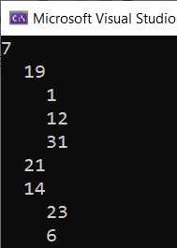
Tree<int> Structure – Example
First, install the SimpleTreeNode NuGet package
Use the given code to create a tree
TreeNode<int> tree = new TreeNode<int>(7,
new TreeNode<int>(19,
new TreeNode<int>(1),
new TreeNode<int>(12),
new TreeNode<int>(31)
),
new TreeNode<int>(21),
new TreeNode<int>(14,
new TreeNode<int>(23),
new TreeNode<int>(6)
)
);
Console.WriteLine(tree);
12

Slide 13
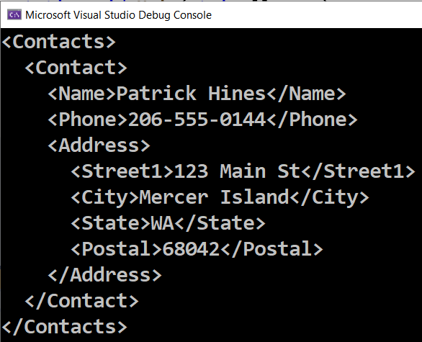
Example: XML Tree in C#
XElement contacts =
new XElement("Contacts",
new XElement("Contact",
new XElement("Name", "Patrick Hines"),
new XElement("Phone", "206-555-0144"),
new XElement("Address",
new XElement("Street1", "123 Main St"),
new XElement("City", "Mercer Island"),
new XElement("State", "WA"),
new XElement("Postal", "68042")
)
)
);
Console.WriteLine(contacts);
13

Slide 14
DFS and BFS Traversals

Slide 15
Tree Traversal Algorithms
Traversing a tree means to visit each of its nodes exactly once
The order of visiting nodes may vary on the traversal algorithm
Depth-First Search (DFS)
Visit node's successors first
Usually implemented by recursion
Breadth-First Search (BFS)
Nearest nodes visited first
Implemented by a queue

Slide 16
Breadth-First Search (BFS)
Breadth-First Search (BFS) first visits the neighbor nodes, then the neighbors of neighbors, etc.
BFS algorithm pseudo code:
1
7
BFS (node) {
queue ← node
while queue not empty
v ← queue
print v
for each child c of v
queue ← c
}
2
19
3
21
4
14
5
6
7
8
9
1
12
31
23
6

Slide 17
BFS in Action (Step 1)
Initially enqueue the root node
7
19
21
14
1
12
31
23
6
Queue: 7
Output:

Slide 18
BFS in Action (Step 2)
Remove from the queue the next node and print it
7
19
21
14
1
12
31
23
6
Queue: 7
Output: 7

Slide 19
BFS in Action (Step 3)
Enqueue all children of the current node
7
19
21
14
1
12
31
23
6
Queue: 7, 19
Output: 7

Slide 20
BFS in Action (Step 4)
Enqueue all children of the current node
7
19
21
14
14
23
23
6
1
12
6
12
31
31
Queue: 7, 19, 21
Output: 7

Slide 21
BFS in Action (Step 5)
Enqueue all children of the current node
7
19
21
14
1
12
31
23
6
Queue: 7, 19, 21, 14
Output: 7

Slide 22
BFS in Action (Step 6)
Remove from the queue the next node and print it
7
19
21
14
1
12
31
23
6
Queue: 7, 19, 21, 14
Output: 7, 19

Slide 23
BFS in Action (Step 7)
Enqueue all children of the current node
7
19
21
14
1
12
31
23
6
Queue: 7, 19, 21, 14, 1
Output: 7, 19

Slide 24
BFS in Action (Step 8)
Enqueue all children of the current node
7
19
21
14
1
12
31
23
6
Queue: 7, 19, 21, 14, 1, 12
Output: 7, 19

Slide 25
BFS in Action (Step 9)
Enqueue all children of the current node
7
19
21
14
1
12
31
23
6
Queue: 7, 19, 21, 14, 1, 12, 31
Output: 7, 19

Slide 26
BFS in Action (Step 10)
Remove from the queue the next node and print it
7
19
21
14
No child nodes to enqueue
1
12
31
23
6
Queue: 7, 19, 21, 14, 1, 12, 31
Output: 7, 19, 21

Slide 27
BFS in Action (Step 11)
Remove from the queue the next node and print it
7
19
21
14
1
12
31
23
6
Queue: 7, 19, 21, 14, 1, 12, 31
Output: 7, 19, 21, 14

Slide 28
BFS in Action (Step 12)
Enqueue all children of the current node
7
19
21
14
1
12
31
23
6
Queue: 7, 19, 21, 14, 1, 12, 31, 23
Output: 7, 19, 21, 14

Slide 29
BFS in Action (Step 13)
Enqueue all children of the current node
7
19
21
14
1
12
31
23
6
Queue: 7, 19, 21, 14, 1, 12, 31, 23, 6
Output: 7, 19, 21, 14

Slide 30
BFS in Action (Step 14)
Remove from the queue the next node and print it
7
19
21
14
No child nodes to enqueue
1
12
31
23
6
Queue: 7, 19, 21, 14, 1, 12, 31, 23, 6
Output: 7, 19, 21, 14, 1

Slide 31
BFS in Action (Step 15)
Remove from the queue the next node and print it
7
19
21
14
No child nodes to enqueue
1
12
31
23
6
Queue: 7, 19, 21, 14, 1, 12, 31, 23, 6
Output: 7, 19, 21, 14, 1, 12

Slide 32
BFS in Action (Step 16)
Remove from the queue the next node and print it
7
19
21
14
No child nodes to enqueue
1
12
31
23
6
Queue: 7, 19, 21, 14, 1, 12, 31, 23, 6
Output: 7, 19, 21, 14, 1, 12, 31

Slide 33
BFS in Action (Step 17)
Remove from the queue the next node and print it
7
19
21
14
No child nodes to enqueue
1
12
31
23
6
Queue: 7, 19, 21, 14, 1, 12, 31, 23, 6
Output: 7, 19, 21, 14, 1, 12, 31, 23

Slide 34
BFS in Action (Step 18)
Remove from the queue the next node and print it
7
19
21
14
No child nodes to enqueue
1
12
31
23
6
Queue: 7, 19, 21, 14, 1, 12, 31, 23, 6
Output: 7, 19, 21, 14, 1, 12, 31, 23, 6

Slide 35
BFS in Action (Step 19)
The queue is empty → stop
7
19
21
14
1
12
31
23
6
Queue: 7, 19, 21, 14, 1, 12, 31, 23, 6
Output: 7, 19, 21, 14, 1, 12, 31, 23, 6

Slide 36
BFS Example: Traverse Folders
DirectoryInfo class allows accessing directories
static void TraverseDirBFS(string directoryPath) {
var visitedDirsQueue = new Queue<DirectoryInfo>();
visitedDirsQueue.Enqueue(new DirectoryInfo(directoryPath));
while (visitedDirsQueue.Count > 0) {
DirectoryInfo currentDir = visitedDirsQueue.Dequeue();
Console.WriteLine(currentDir.FullName);
DirectoryInfo[] children = currentDir.GetDirectories();
foreach (DirectoryInfo child in children)
visitedDirsQueue.Enqueue(child);
}
}
static void Main() {
TraverseDirBFS(@"C:\Windows\assembly");
}
Store visited directories in a queue
Use GetDirectories() method to get sub-directories
36

Slide 37
Depth-First Search (DFS)
Depth-First Search (DFS) first visits all descendants of given node recursively, finally visits the node itself
DFS algorithm pseudo code:
9
7
DFS (node) {
for each child c of node
DFS(c);
print node;
}
4
19
5
21
8
14
1
2
3
6
7
1
12
31
23
6

Slide 38
DFS in Action (Step 1)
Start DFS from the tree root
7
19
21
14
1
12
31
23
6
Stack: 7
Output: (empty)

Slide 39
DFS in Action (Step 2)
Stack: 7, 19
Output: (empty)
Enter recursively into the first child
7
19
21
14
1
12
31
23
6

Slide 40
DFS in Action (Step 3)
Enter recursively into the first child
7
19
21
14
1
12
31
23
6
Stack: 7, 19, 1
Output: (empty)

Slide 41
DFS in Action (Step 4)
Stack: 7, 19
Output: 1
Return back from recursion and print the last visited node
7
19
21
14
1
12
31
23
6

Slide 42
DFS in Action (Step 5)
Stack: 7, 19, 12
Output: 1
Enter recursively into the first child
7
19
21
14
1
12
31
23
6

Slide 43
DFS in Action (Step 6)
Stack: 7, 19
Output: 1, 12
Return back from recursion and print the last visited node
7
19
21
14
1
12
31
23
6

Slide 44
DFS in Action (Step 7)
Stack: 7, 19, 31
Output: 1, 12
Enter recursively into the first child
7
19
21
14
1
12
31
23
6

Slide 45
DFS in Action (Step 8)
Stack: 7, 19
Output: 1, 12, 31
Return back from recursion and print the last visited node
7
19
21
14
1
12
31
23
6

Slide 46
DFS in Action (Step 9)
Stack: 7
Output: 1, 12, 31, 19
Return back from recursion and print the last visited node
7
19
21
14
1
12
31
23
6

Slide 47
DFS in Action (Step 10)
Stack: 7, 21
Output: 1, 12, 31, 19
Enter recursively into the first child
7
19
21
14
1
12
31
23
6

Slide 48
DFS in Action (Step 11)
Stack: 7
Output: 1, 12, 31, 19, 21
Return back from recursion and print the last visited node
7
19
21
14
1
12
31
23
6

Slide 49
DFS in Action (Step 12)
Stack: 7, 14
Output: 1, 12, 31, 19, 21
Enter recursively into the first child
7
19
21
14
1
12
31
23
6

Slide 50
DFS in Action (Step 13)
Stack: 7, 14, 23
Output: 1, 12, 31, 19, 21
Enter recursively into the first child
7
19
21
14
1
12
31
23
6

Slide 51
DFS in Action (Step 14)
Stack: 7, 14
Output: 1, 12, 31, 19, 21, 23
Return back from recursion and print the last visited node
7
19
21
14
1
12
31
23
6

Slide 52
DFS in Action (Step 15)
Stack: 7, 14, 6
Output: 1, 12, 31, 19, 21, 23
Enter recursively into the first child
7
19
21
14
1
12
31
23
6

Slide 53
DFS in Action (Step 16)
Stack: 7, 14
Output: 1, 12, 31, 19, 21, 23, 6
Return back from recursion and print the last visited node
7
19
21
14
1
12
31
23
6

Slide 54
DFS in Action (Step 17)
Stack: 7
Output: 1, 12, 31, 19, 21, 23, 6, 14
Return back from recursion and print the last visited node
7
19
21
14
1
12
31
23
6

Slide 55
DFS in Action (Step 18)
Stack: (empty)
Output: 1, 12, 31, 19, 21, 23, 6, 14, 7
DFS traversal finished
7
19
21
14
1
12
31
23
6

Slide 56
DFS Example: Traverse Folders
private static void TraverseDir(DirectoryInfo dir, string spaces)
{
Console.WriteLine(spaces + dir.FullName);
DirectoryInfo[] children = dir.GetDirectories();
foreach (DirectoryInfo child in children)
TraverseDir(child, spaces + " ");
}
static void TraverseDir(string directoryPath)
{
TraverseDir(new DirectoryInfo(directoryPath), string.Empty);
}
static void Main()
{
TraverseDir(@"C:\Windows\assembly");
}
Use recursion to traverse folders
56

Slide 57
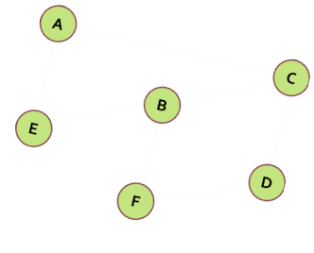
Graphs

Slide 58
Graph Definitions
Node (vertex)
Element of a graph
Can have name / value
Keeps a list of adjacent nodes
Edge
Connection between two nodes
Can be directed / undirected
Can be weighted / unweighted
Can have name / value
Node
A
Edge
A
B

Slide 59
Graph Data Structure
Graph, denoted as G(V, E)
Set of nodes V with many-to-many relationship between them (edges E)
Each node (vertex) has multiple predecessors and multiple successors
Edges connect two nodes (vertices)
Node with multiple successors
Edge
Node with multiple predecessors
7
1
14
4
21
Self-relationship (loop)
Node
11
12
19
31

Slide 60
Graph Definitions: Directed / Undirected
Directed graph
Edges have direction
Undirected graph
Undirected edges
22
2
A
F
3
J
7
1
4
D
G
21
12
19
E
C
H
3

Slide 61
Graph Definitions: Weighted Graph
Weighted graph
Weight (cost) is associated with each edge
Weight
10
A
F
4
Weight
5
N
J
6
16
8
Q
D
7
22
G
9
3
14
K
E
C
H

Slide 62
Graph Definitions: Path
Path (in undirected graph)
Sequence of nodes n₁, n₂, … n_{k}
Edge exists between each pair of nodes n_{i}, n_{i+1}
Examples:
A, B, C is a path
A, B, G, N, K is a path
H, K, C is not a path
H, G, G, B, N is not a path
B
C
A
G
K
H
N

Slide 63
Graph Definitions: Directed Path
Path (in directed graph)
Sequence of nodes n₁, n₂, … n_{k}
Directed edge exists between each pair of nodes n_{i}, n_{i+1}
Examples:
A, B, C is a path
N, G, A, B, C is a path
A, G, K is not a path
H, G, K, N is not a path
B
C
A
G
K
H
N

Slide 64
Graph Definitions: Cycles
Cycle
Path that ends back at the starting node
Example of cycle: A, B, C, G, A
Simple path
No cycles in path
Acyclic graph
Graph with no cycles
Acyclic undirected graphs are trees
B
C
A
G
K
H
N

Slide 65
Graph Definitions: Connectivity
Two nodes are reachable if а path exists between them
Connected graph
Every two nodes are reachable from each other
Disconnected graph holding two connected components
Connected graph
A
F
J
A
F
D
G
J
D
G
E
H
C

Slide 66
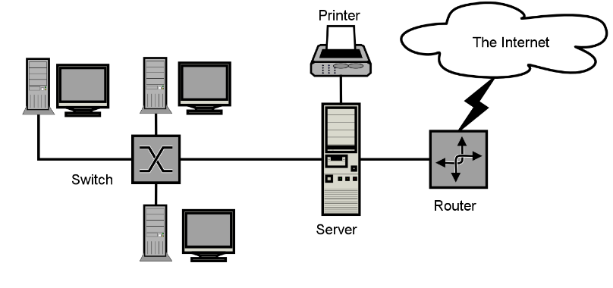


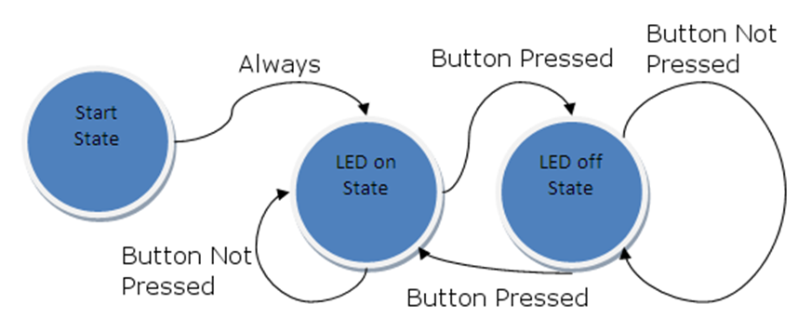
Graphs and Their Applications
Graphs have many real-world applications
Modeling a computer network
Routes are paths in the network
Modeling a city map
Streets are edges, crossings are vertices
Social networks
People are nodes and their connections are edges
State machines
States are nodes, transitions are edges

Slide 67
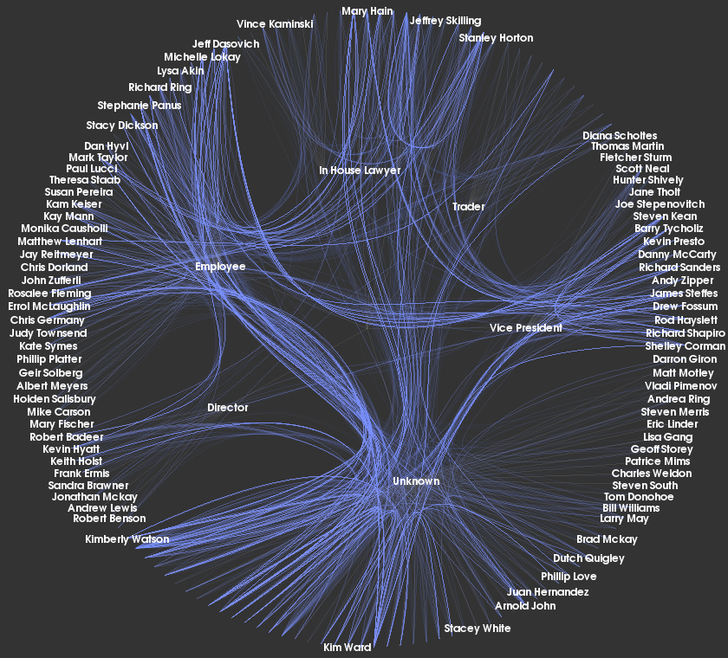
Classic and OOP Ways
{1,2} {1,4} {2,3} {3,1} {4,2}

Slide 68
Representing Graphs
1 → {2, 4}
2 → {3}
3 → {1}
4 → {2}
Adjacency list
Each node holds a list of its neighbors
Adjacency matrix
Each cell keeps whether and how two nodes are connected
List of edges
3
2
1
4
1
2
3
4
1
0 | 1 | 0 | 1
0 | 0 | 1 | 0
1 | 0 | 0 | 0
0 | 1 | 0 | 0
2
{1,2} {1,4} {2,3} {3,1} {4,2}
3
4

Slide 69
Graph Representation: Adjacency List
var g = new List<int>[]
{
new List<int> {3, 6},
new List<int> {2, 3, 4, 5, 6},
new List<int> {1, 4, 5},
new List<int> {0, 1, 5},
new List<int> {1, 2, 6},
new List<int> {1, 2, 3},
new List<int> {0, 1, 4}
};
g[3].Add(6); // Add an edge { 3 → 6 }
var childNodes = g[1]; // List the children of node #1
0
6
3
1
4
5
2
69

Slide 70
Graph Representation: Adjacency Matrix
var graph = new[,]
{ // 0 1 2 3 4 5 6
{ 0, 0, 0, 1, 0, 0, 1 }, // node 0
{ 0, 0, 1, 1, 1, 1, 1 }, // node 1
{ 0, 1, 0, 0, 1, 1, 0 }, // node 2
{ 1, 1, 0, 0, 0, 1, 0 }, // node 3
{ 0, 1, 1, 0, 0, 0, 1 }, // node 4
{ 0, 1, 1, 1, 0, 0, 0 }, // node 5
{ 1, 1, 0, 0, 1, 0, 0 }, // node 6
};
g[3, 6] = 1; // Add an edge { 3 → 6 }
var childNodes = g[1]; // List the children of node #1
0
6
3
1
4
5
2
70

Slide 71
Graph Representation: List of Edges
class Edge
{
public int Parent { get; set; }
public int Child { get; set; }
}
var graph = new List<Edge>() {
new Edge() { Parent = 0, Child = 3 },
new Edge() { Parent = 0, Child = 6 },
…
}
// Add an edge { 3 → 6 }
graph.Add(new Edge() { Parent = 3, Child = 6 });
// List the children of node #1
var childNodes = graph.Where(e => e.Parent == 1);
0
6
3
1
4
5
2
71

Slide 72
Numbering Graph Nodes
A common technique to speed up working with graphs
Numbering the nodes and accessing them by index (not by name)
0
Ruse
6
Plovdiv
3
Varna
1
Sofia
4
Bourgas
5
Stara Zagora
2
Pleven
Graph of numbered nodes: [0…6]
Graph of named nodes

Slide 73
Numbering Graph Nodes – How?
Suppose we have a graph of n nodes
We can assign a number for each node in the range [0…n-1]
0
Ruse
6
# | Node
0 | Ruse
1 | Sofia
2 | Pleven
3 | Varna
4 | Bourgas
5 | Stara Zagora
6 | Plovdiv
Plovdiv
3
Varna
1
Sofia
4
Bourgas
Stara Zagora
5
2
Pleven
var g =
new List<int>[n]
var g = new Dictionary<
string, List<string>>

Slide 74
Graph of Named Nodes – Example
var graph = new Dictionary<string, List<string>>() {
{ "Sofia", new List<string>() {
"Plovdiv", "Varna", "Bourgas", "Pleven", "Stara Zagora" } },
{ "Plovdiv", new List<string>() {
"Bourgas", "Ruse" } },
{ "Varna", new List<string>() {
"Ruse", "Stara Zagora" } },
{ "Bourgas", new List<string>() {
"Plovdiv", "Pleven" } },
{ "Ruse", new List<string>() {
"Varna", "Plovdiv" } },
{ "Pleven", new List<string>() {
"Bourgas", "Stara Zagora" } },
{ "Stara Zagora", new List<string>() {
"Varna", "Pleven" } },
};
Ruse
Plovdiv
Varna
Sofia
Bourgas
Stara Zagora
Pleven
74

Slide 75
Graph of Numbered Nodes – Example
public class Graph
{
List<int>[] childNodes;
string[] nodeNames;
}
Graph g = new Graph(new List<int>[] {
new List<int> {3, 6}, // children of node 0 (Ruse)
new List<int> {2, 3, 4, 5, 6}, // successors of node 1 (Sofia)
new List<int> {1, 4, 5}, // successors of node 2 (Pleven)
new List<int> {0, 1, 5}, // successors of node 3 (Varna)
new List<int> {1, 2, 6}, // successors of node 4 (Bourgas)
new List<int> {1, 2, 3}, // successors of node 5 (Stara Zagora)
new List<int> {0, 1, 4} // successors of node 6 (Plovdiv)
},
new string[] {"Ruse", "Sofia", "Pleven", "Varna", "Bourgas", … });
0
6
3
1
4
5
2
75

Slide 76
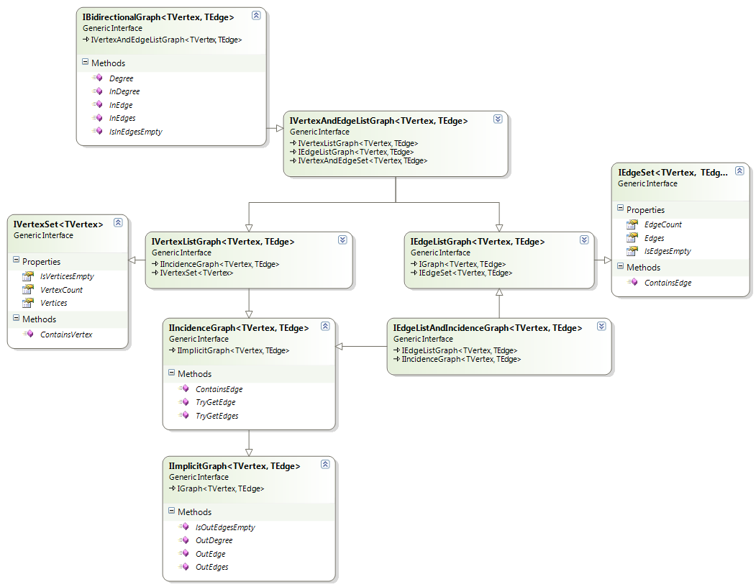
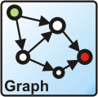
OOP-Based-Graph Representation
Using OOP:
Class Node
Class Edge (Connection)
Class Graph
Optional classes
Algorithm classes
Using external graph and algorithms library:
QuikGraph – nuget.org/packages/QuikGraph

Slide 77
Summary
…
…
…
Trees are recursive data structures
A tree is a node holding a set of children (which are also nodes)
Edges connect nodes
DFS traversal → children first
BFS traversal → root first

Slide 78
Summary
…
…
…
Representing graphs in the memory
Adjacency list holding each node's children
Adjacency matrix
List of edges
Numbering the nodes for faster access
Depth-First Search (DFS) – recursive in-depth traversal
Breadth-First Search (BFS) – in-width traversal with a queue

Slide 79
Questions?
Notes:
79

Slide 80

License
This course (slides, examples, demos, exercises, homework, documents, videos and other assets) is copyrighted content
Unauthorized copy, reproduction or use is illegal
© SoftUni – https://softuni.org
© Software University – https://softuni.bg
Notes:
80

Slide 81
Trainings @ Software University (SoftUni)
Software University – High-Quality Education, Profession and Job for Software Developers
softuni.bg, softuni.org
Software University Foundation
softuni.foundation
Software University @ Facebook
facebook.com/SoftwareUniversity
Software University Forums
forum.softuni.bg
81
Notes:
81

